Slide 1


Claudio Lutz
05.10.2022

Slide 2

Outline
Executive Summary
Introduction
Methodology
Results
Conclusion
Appendix

Slide 3
Executive Summary
Summary of methodologies
Data Collection through API
Data Collection with Web Scraping
Data Wrangling
Exploratory Data Analysis with SQL
Exploratory Data Analysis with Data Visualization
Interactive Visual Analytics with Folium
Predictive Analysis (Classification)
Summary of all results
Exploratory Data Analysis result
Interactive analytics in screenshots
Predictive Analytics result

Slide 4
Introduction
Project background and context
Space X advertises Falcon 9 rocket launches on its website with a cost of 62 million dollars; other providers cost upward of 165 million dollars each, much of the savings is because Space X can reuse the first stage. Therefore if we can determine if the first stage will land, we can determine the cost of a launch. This information can be used if an alternate company wants to bid against space X for a rocket launch.
Problems you want to find answers
Predicting whether the first stage will land, with regard to the different influencing factors
What are the most ideal conditions to guarantee a successful landing

Slide 5

Section 1

Slide 6
Methodology
Executive Summary
Data collection methodology:
Using the SpaceX API and web scraping from Wikipedia
Perform data wrangling
One-hot encoding was applied to categorical features
The Labels were created as column Landing_Class
Perform exploratory data analysis (EDA) using visualization and SQL
Perform interactive visual analytics using Folium and Plotly Dash
Perform predictive analysis using classification models
How to build, tune, evaluate classification models

Slide 7
Data Collection
Describe how data sets were collected.
Using the requests library, a connection to the SpaceX API is established.
The loaded Json response content was converted into a Pandas dataframe using .json_normalize()
Further I was extracting a table from Falcon 9 launch records from Wikipedia using beautiful soup and convert it to a pandas dataframe.

Slide 8
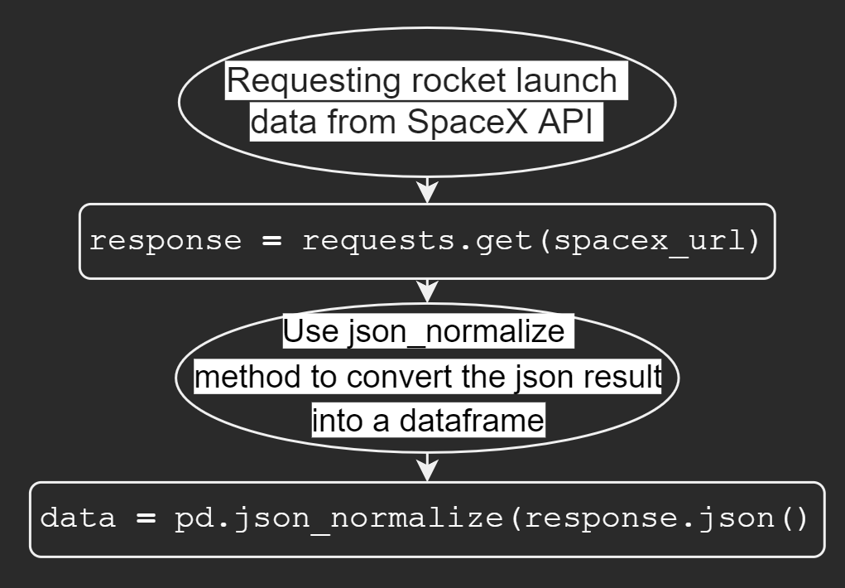
Data Collection – SpaceX API
Collecting the SpaceX-Data from the REST-Api with get request and used json_normalize to convert the collected data to a pandas dataframe.
Link to the Notebook: https://github.com/ClaudioLutz/IBM-Data-Science-and-Machine-Learning-Capstone-Project/blob/master/jupyter-labs-spacex-data-collection-api.ipynb

Slide 9
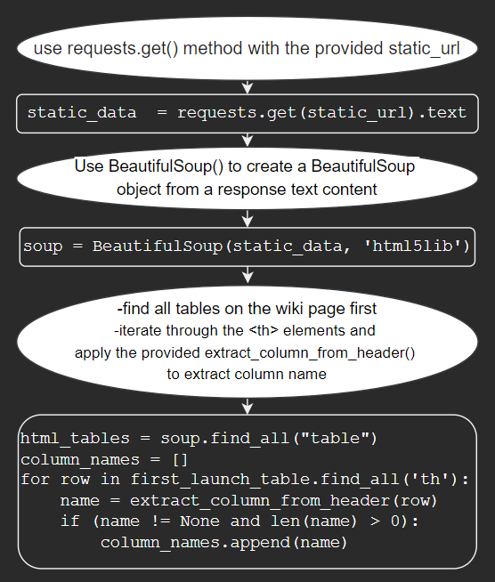
Data Collection - Scraping
Extracting the HTML from Wikipedia with requests and collecting the relevant column names with BeautifulSoup find_all()
A dictionary with the column-names as keys was then parsed with the correspondent values of the columns.
The Link to the Notebook: https://github.com/ClaudioLutz/IBM-Data-Science-and-Machine-Learning-Capstone-Project/blob/master/jupyter-labs-webscraping.ipynb

Slide 10

Data Wrangling
Exploratory data analysis: -Calculating the number of launches at each site -Calculating the number and occurrence of each orbits -Calculating the number and occurrence of mission outcome per orbit type
Creating a landing outcome label from Outcome column

Slide 11
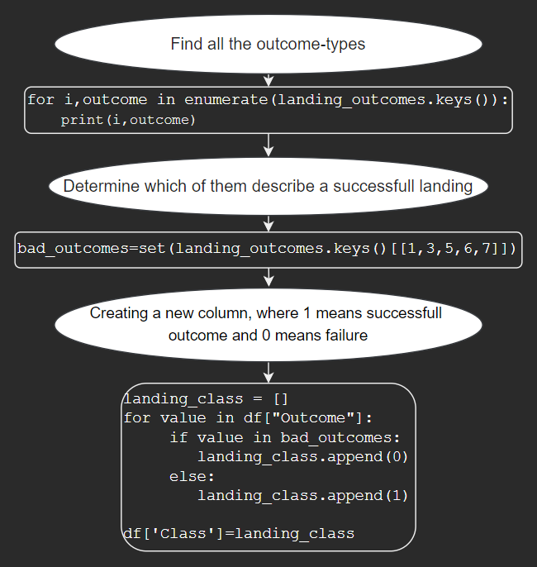
Data Wrangling
Creating a landing outcome label from Outcome column
The link to the notebook: https://github.com/ClaudioLutz/IBM-Data-Science-and-Machine-Learning-Capstone-Project/blob/master/labs-jupyter-spacex-Data%20wrangling.ipynb

Slide 12
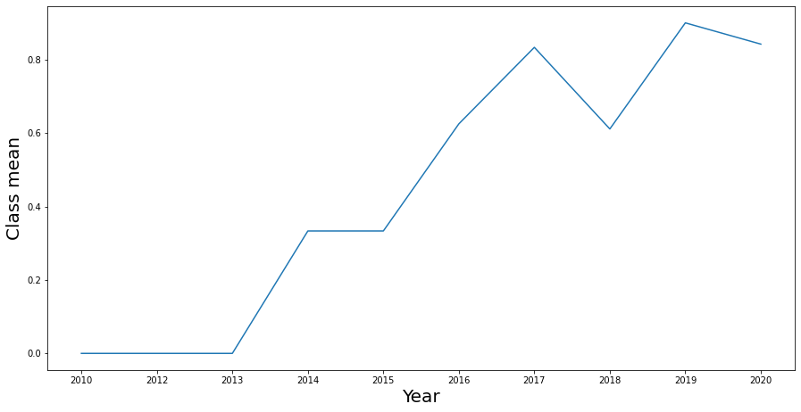
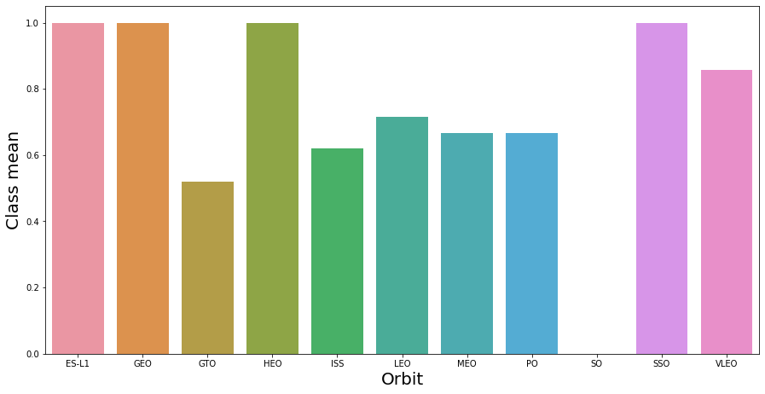
EDA with Data Visualization
We explored the data by visualizing the relationship between flight number and launch Site, payload and launch site, success rate of each orbit type, flight number and orbit type, the launch success yearly trend.
Link to the Notebook: https://github.com/ClaudioLutz/IBM-Data-Science-and-Machine-Learning-Capstone-Project/blob/master/jupyter-labs-eda-dataviz.ipynb

Slide 13
EDA with SQL
We wrote queries to find out for instance:
Display the names of the unique launch sites in the space mission
Display 5 records where launch sites begin with the string 'KSC’
Display the total payload mass carried by boosters launched by NASA (CRS)
Display average payload mass carried by booster version F9 v1.1
List the date where the first successful landing outcome in drone ship was acheived.
List the names of the boosters which have success in ground pad and have payload mass greater than 4000 but less than 6000
List the total number of successful and failure mission outcomes
List the names of the booster_versions which have carried the maximum payload mass. Use a subquery
List the records which will display the month names, succesful landing_outcomes in ground pad ,booster versions, launch_site for the months in year 2017
Rank the count of successful landing_outcomes between the date 2010-06-04 and 2017-03-20 in descending order.
Notebook: https://github.com/ClaudioLutz/IBM-Data-Science-and-Machine-Learning-Capstone-Project/blob/master/jupyter-labs-eda-sql-edx.ipynb

Slide 14
Build an Interactive Map with Folium
Mark the success/failed launches for each site on the map
Adding a red or green folium.Marker for each launch result to determine the launch sites with relatively high success rate
Calculating the distances between a launch site to its proximities
Are launch sites near railways, highways and coastlines.
Do launch sites keep certain distance away from cities.
Link to the notebook: https://github.com/ClaudioLutz/IBM-Data-Science-and-Machine-Learning-Capstone-Project/blob/master/lab_jupyter_launch_site_location.ipynb

Slide 15
Build a Dashboard with Plotly Dash
Interactive Dashboard with Plotly Dash
Pie charts showing total launches by certain sites
Scatter graph showing relationship of Outcome and Payload Mass (Kg) for different booster versions.
Link to the notebook: https://github.com/ClaudioLutz/IBM-Data-Science-and-Machine-Learning-Capstone-Project/blob/master/SpaceX_Launch_Records_Dashboard.py

Slide 16
Predictive Analysis (Classification)
Create a NumPy array from the column Class for the labels and standardize the data for the features.
We split the data into training and testing data using the function train_test_split. and finding the best hyperparameters with GridSearchCV()
We calculated the accuracy of the models the method score and found the best performing model.
Link to the notebook: https://github.com/ClaudioLutz/IBM-Data-Science-and-Machine-Learning-Capstone-Project/blob/master/SpaceX_Machine%20Learning%20Prediction_Part_5.ipynb

Slide 17
Results
Exploratory data analysis results
Interactive analytics demo in screenshots
Predictive analysis results

Slide 18

Section 2

Slide 19
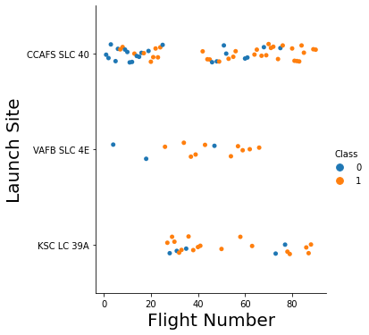
Flight Number vs. Launch Site
Conclusion:
The larger the number of flights from a launch-site the higher the successrate

Slide 20
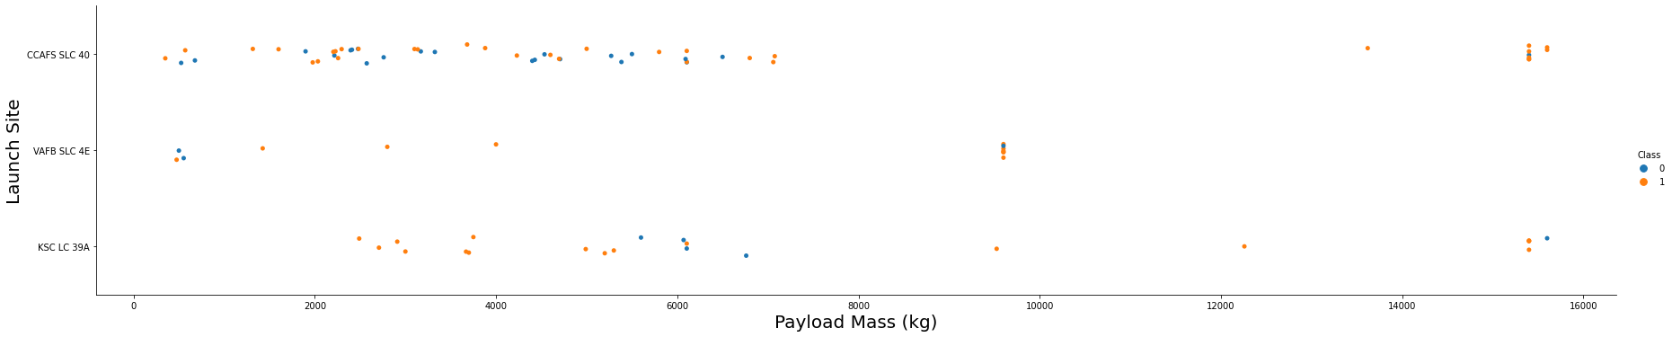
Payload vs. Launch Site
A higher payload mass translates directly to a higher success rate.

Slide 21
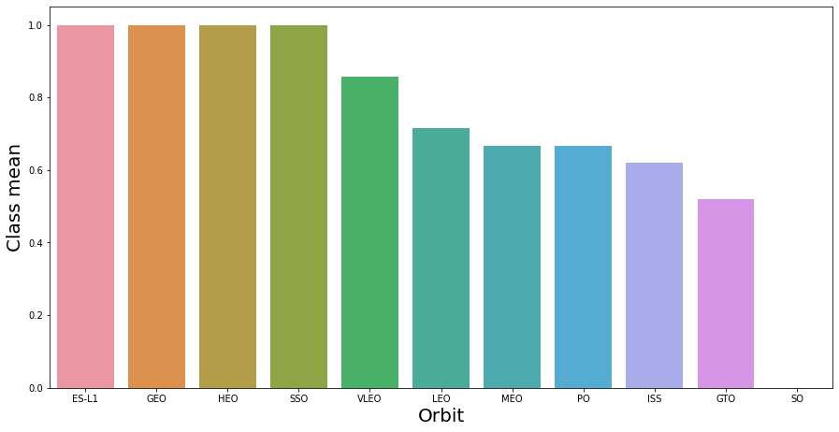
Success Rate vs. Orbit Type
ES-L1, GEO, HEO, SSO have a 100% and SO has a 0% successrate

Slide 22
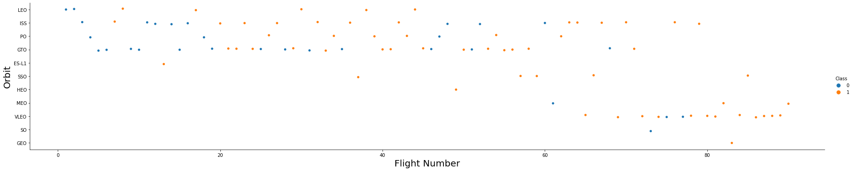
Flight Number vs. Orbit Type
It appears, that in the LEO orbit success is related to the number of flights; on the other hand, there seems to be no relationship between flight number when in GTO orbit.

Slide 23
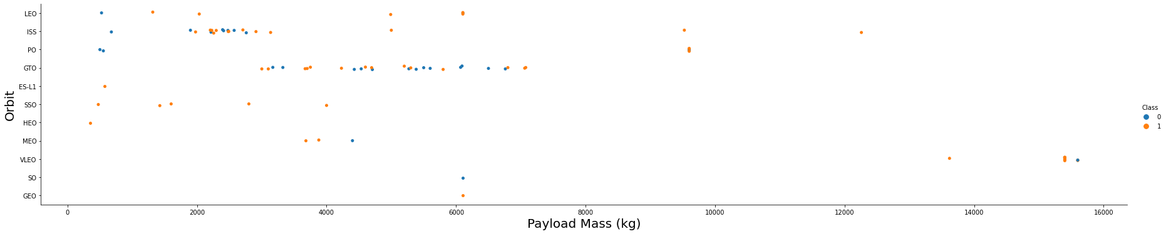
Payload vs. Orbit Type
With heavy payloads the successful landing or positive landing rate are more for Polar,LEO and ISS. However for GTO we cannot distinguish this well as both positive landing rate and negative landing(unsuccessful mission) are both there here.

Slide 24
Launch Success Yearly Trend
The success rate since 2013 kept increasing till 2020

Slide 25
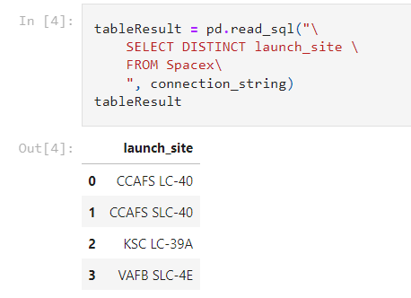
All Launch Site Names
Selecting the unique launch site names using the distinct key-word

Slide 26
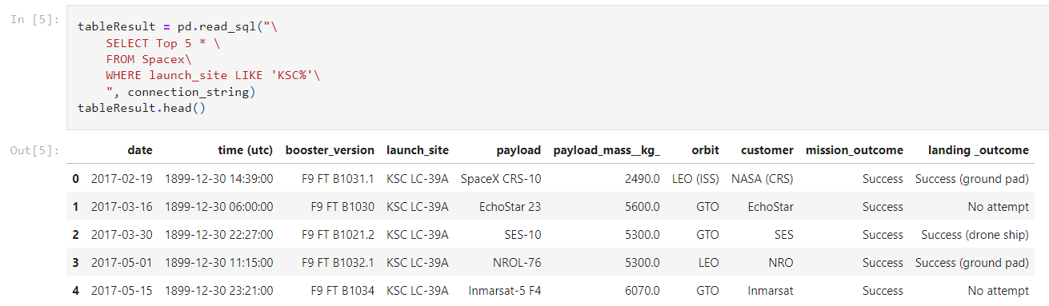
Launch Site Names Begin with 'KSC'
Display 5 records where launch sites begin with the string 'KSC'

Slide 27
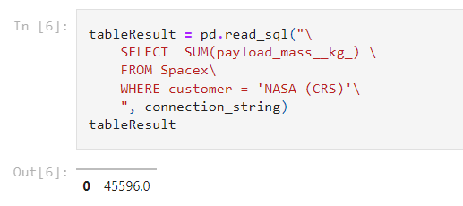
Total Payload Mass
Display the total payload mass carried by boosters launched by NASA (CRS)

Slide 28
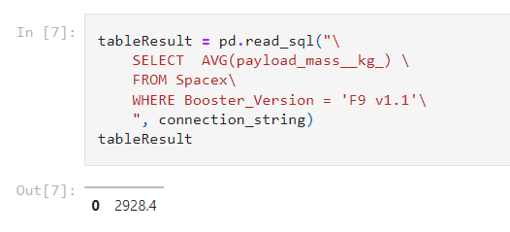
Average Payload Mass by F9 v1.1
Display average payload mass carried by booster version F9 v1.1

Slide 29
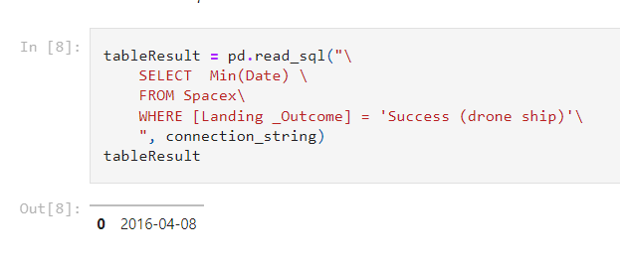
First Successful Drone Ship Landing Date
The date of the first successful landing outcome on a drone ship was 08th April 2016

Slide 30
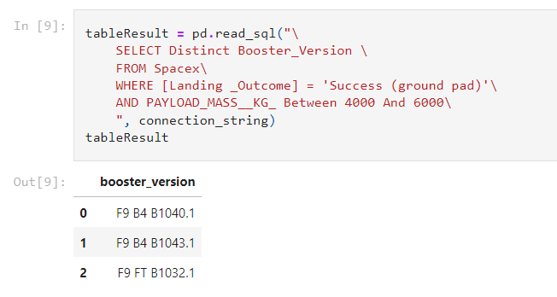
Successful Drone Ship Landing with Payload between 4000 and 6000
List the names of the boosters which have success in ground pad and have payload mass greater than 4000 but less than 6000

Slide 31
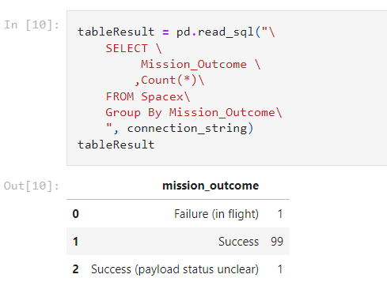
Total Number of Successful and Failure Mission Outcomes
List the total number of successful and failure mission outcomes

Slide 32
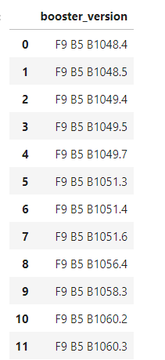
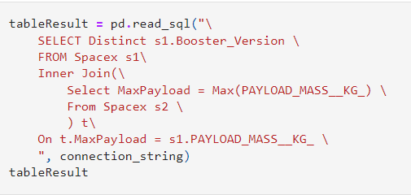
Boosters Carried Maximum Payload
List the names of the booster_versions which have carried the maximum payload mass. Using a subquery

Slide 33
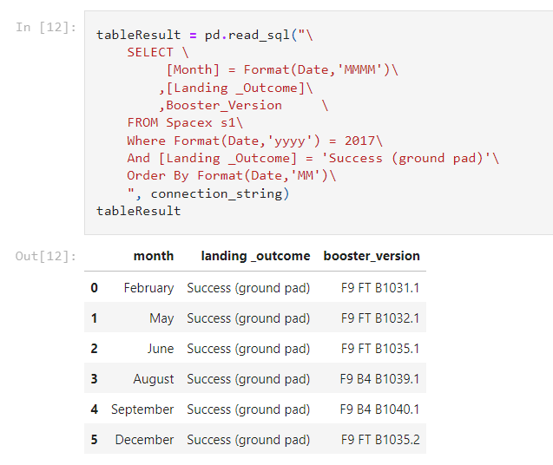
2015 Launch Records
List the records which will display the month names, succesful landing_outcomes in ground pad ,booster versions, launch_site for the months in year 2017

Slide 34
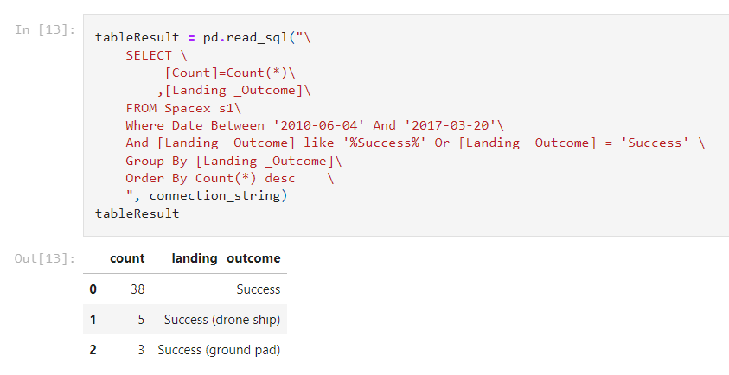
Rank Landing Outcomes Between 2010-06-04 and 2017-03-20
Rank the count of successful landing_outcomes between the date 2010-06-04 and 2017-03-20 in descending order.

Slide 35

Section 3

Slide 36
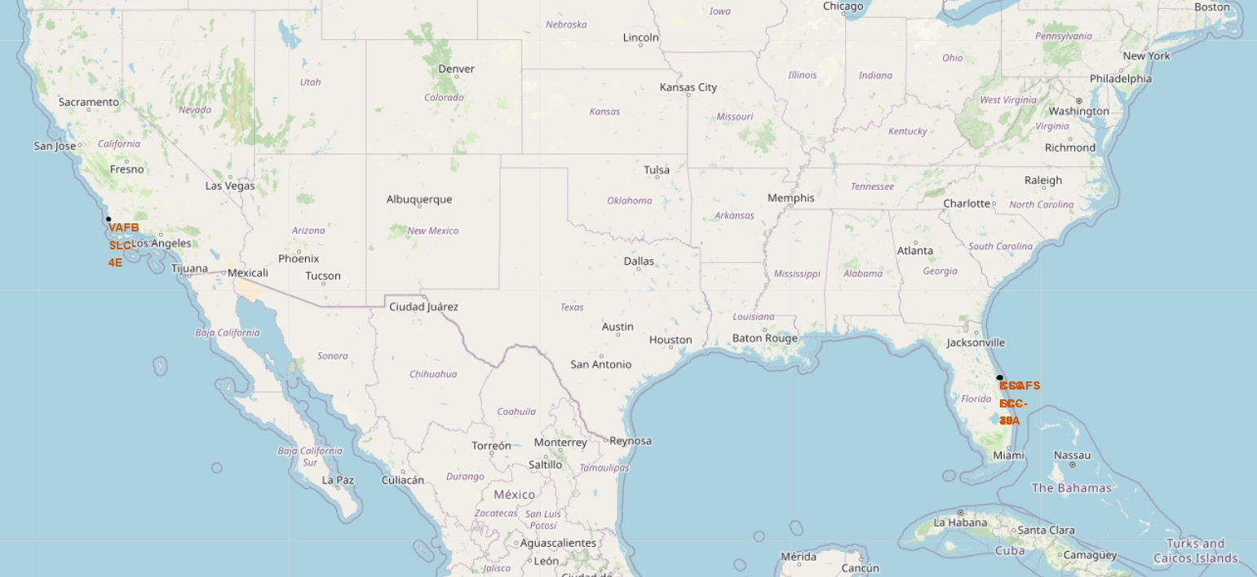
SpaceX Launch Sites
The SpaceX launch sites are in the east and the west coast in the USA

Slide 37
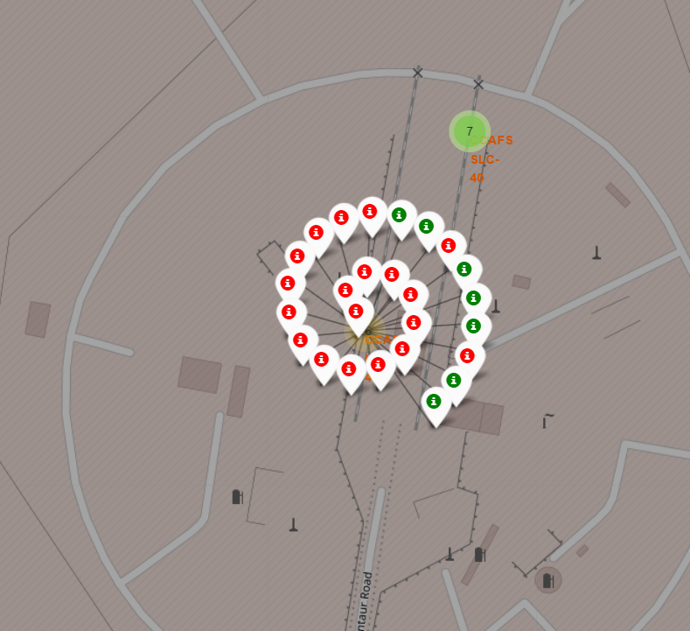
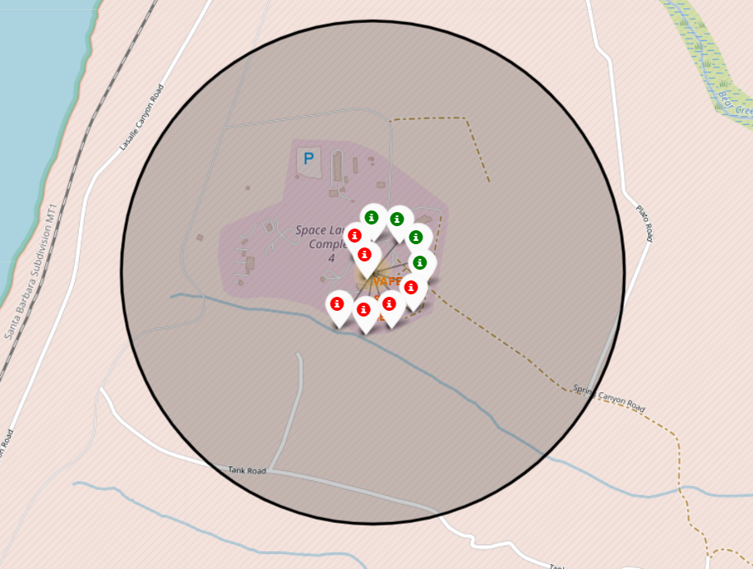
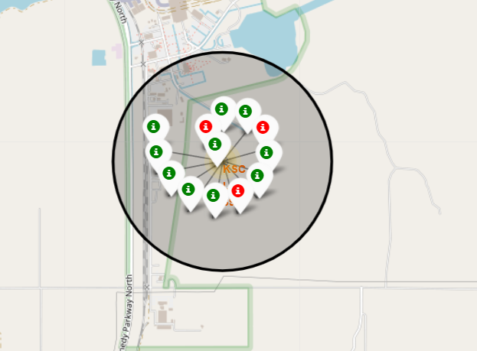
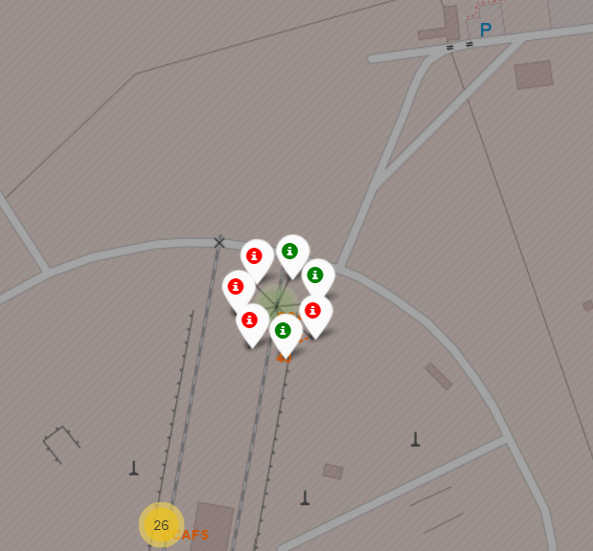
Markers showing launch sites with color labels
Green markers show mission success red markers show mission failure
West Coast near Santa Maria
East Coast near Cape Canaveral
CCAFS LC-40
VAFB SLC-4E
KSC LC-39A
CCAFS SLC-40

Slide 38
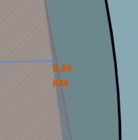
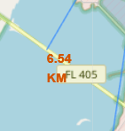
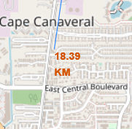
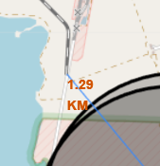
Distance to the proximities
Explanation
Launch sites are near railways and highways for the transportation of heavy materials.
For safety reasons launch sites are near the coast and far away from cities.

Slide 39

Section 4

Slide 40
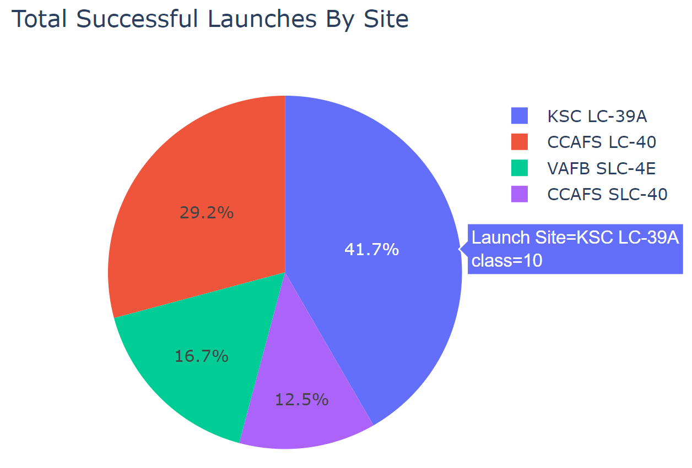
Success percentage achieved by launch site
When all the launch sites are compared; KSC LC-39A (Kennedy Space Center) is the most successful launch-site with a 41.7% success rate over all the missions.

Slide 41
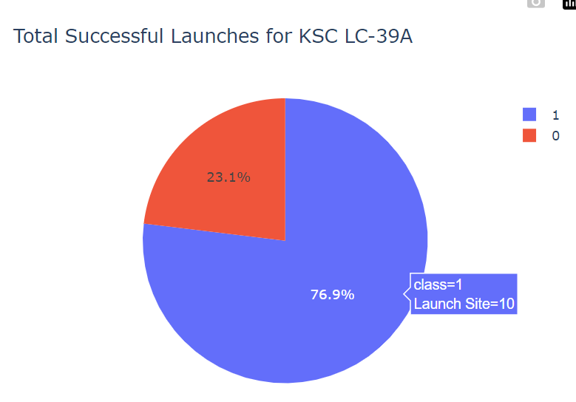
Launch Site With Highest Success Ratio
The launch site with highest launch success ratio was KSC LC-39A (Kennedy Space Center)

Slide 42
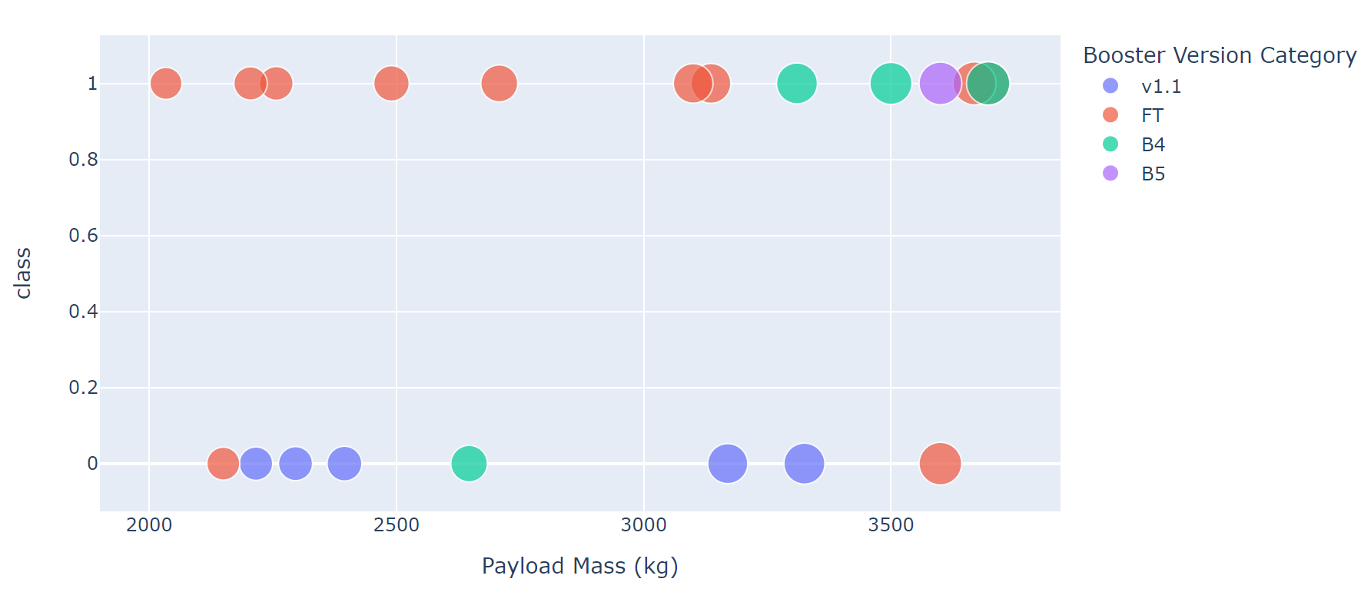
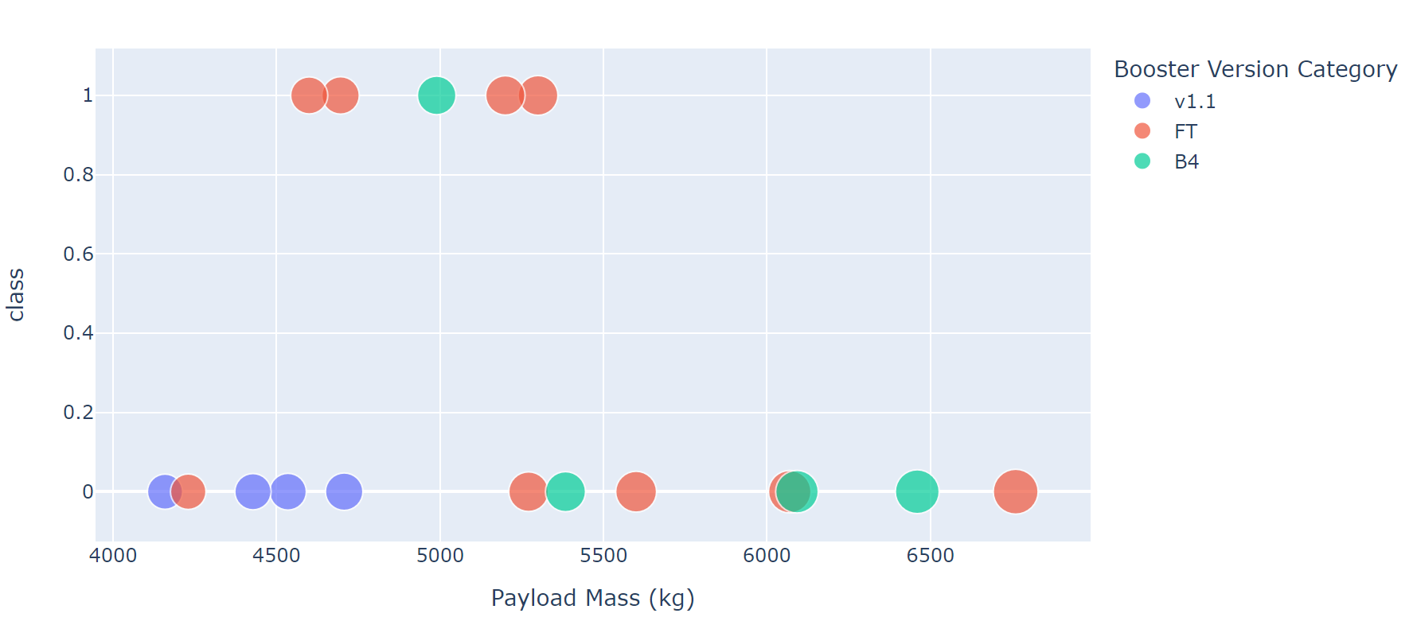
Success Rate By Payload Mass
The success rate of the payload mass from 2000 – 4000 kg is much higher then the success rate from 4000 to 8000 kg

Slide 43

Section 5

Slide 44
Classification Accuracy
The Model with the highest accuracy was the DecisionTreeClassifier

Slide 45
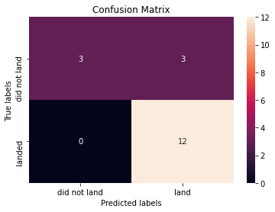
Confusion Matrix
The Model predicted 12 landings correctly but couldn’t predict the 3 unsuccessful landings (false positives).

Slide 46
Conclusions
The larger the number of flights from a launch-site the higher the success rate
The success rate since 2013 kept increasing till 2020
Orbits ES-L1, GEO, HEO, SSO, VLEO had the most success rate.
KSC LC-39A had with 41.7% the most successful launches compared to all sites.
The Decision tree classifier is the machine learning algorithm with the highest accuracy but couldn’t predict unsuccessful landings.

Slide 47
Appendix
Repository for all notebooks, files and data sets: https://github.com/ClaudioLutz/IBM-Data-Science-and-Machine-Learning-Capstone-Project

Slide 48


